Slide 2
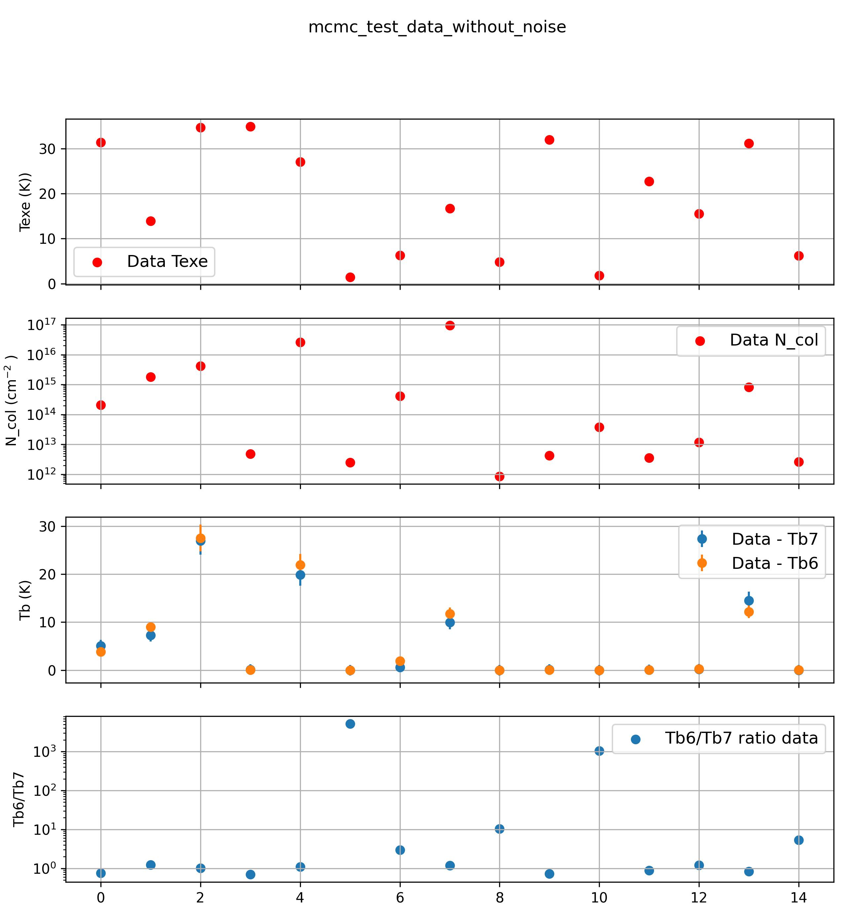
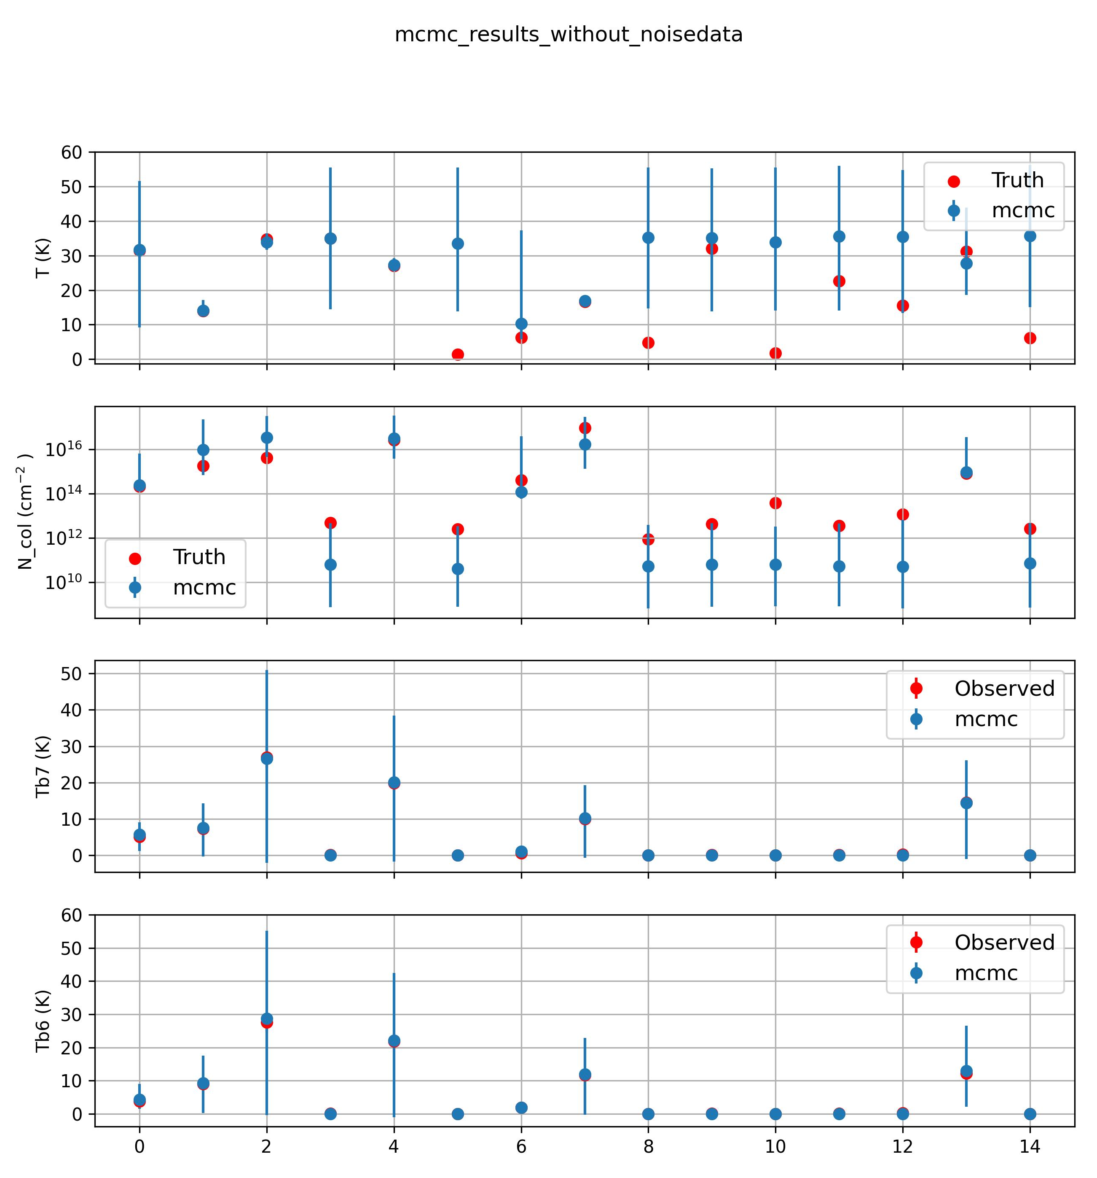
Notes:
Data - Ncol and Texe from Normal distribution around mid values
In general Tb6>Tb7
Observations – When lg(Ncol)<13.5 → Tb6<~Tb7 (i.e points 3,5,8,9 , may be 0)
When Texe ~ 10 K (i.e points 1,4) -- > No noticeable change from normal trend
Results:
For points where col density is low → Large errors in recovering the parameters

Slide 3
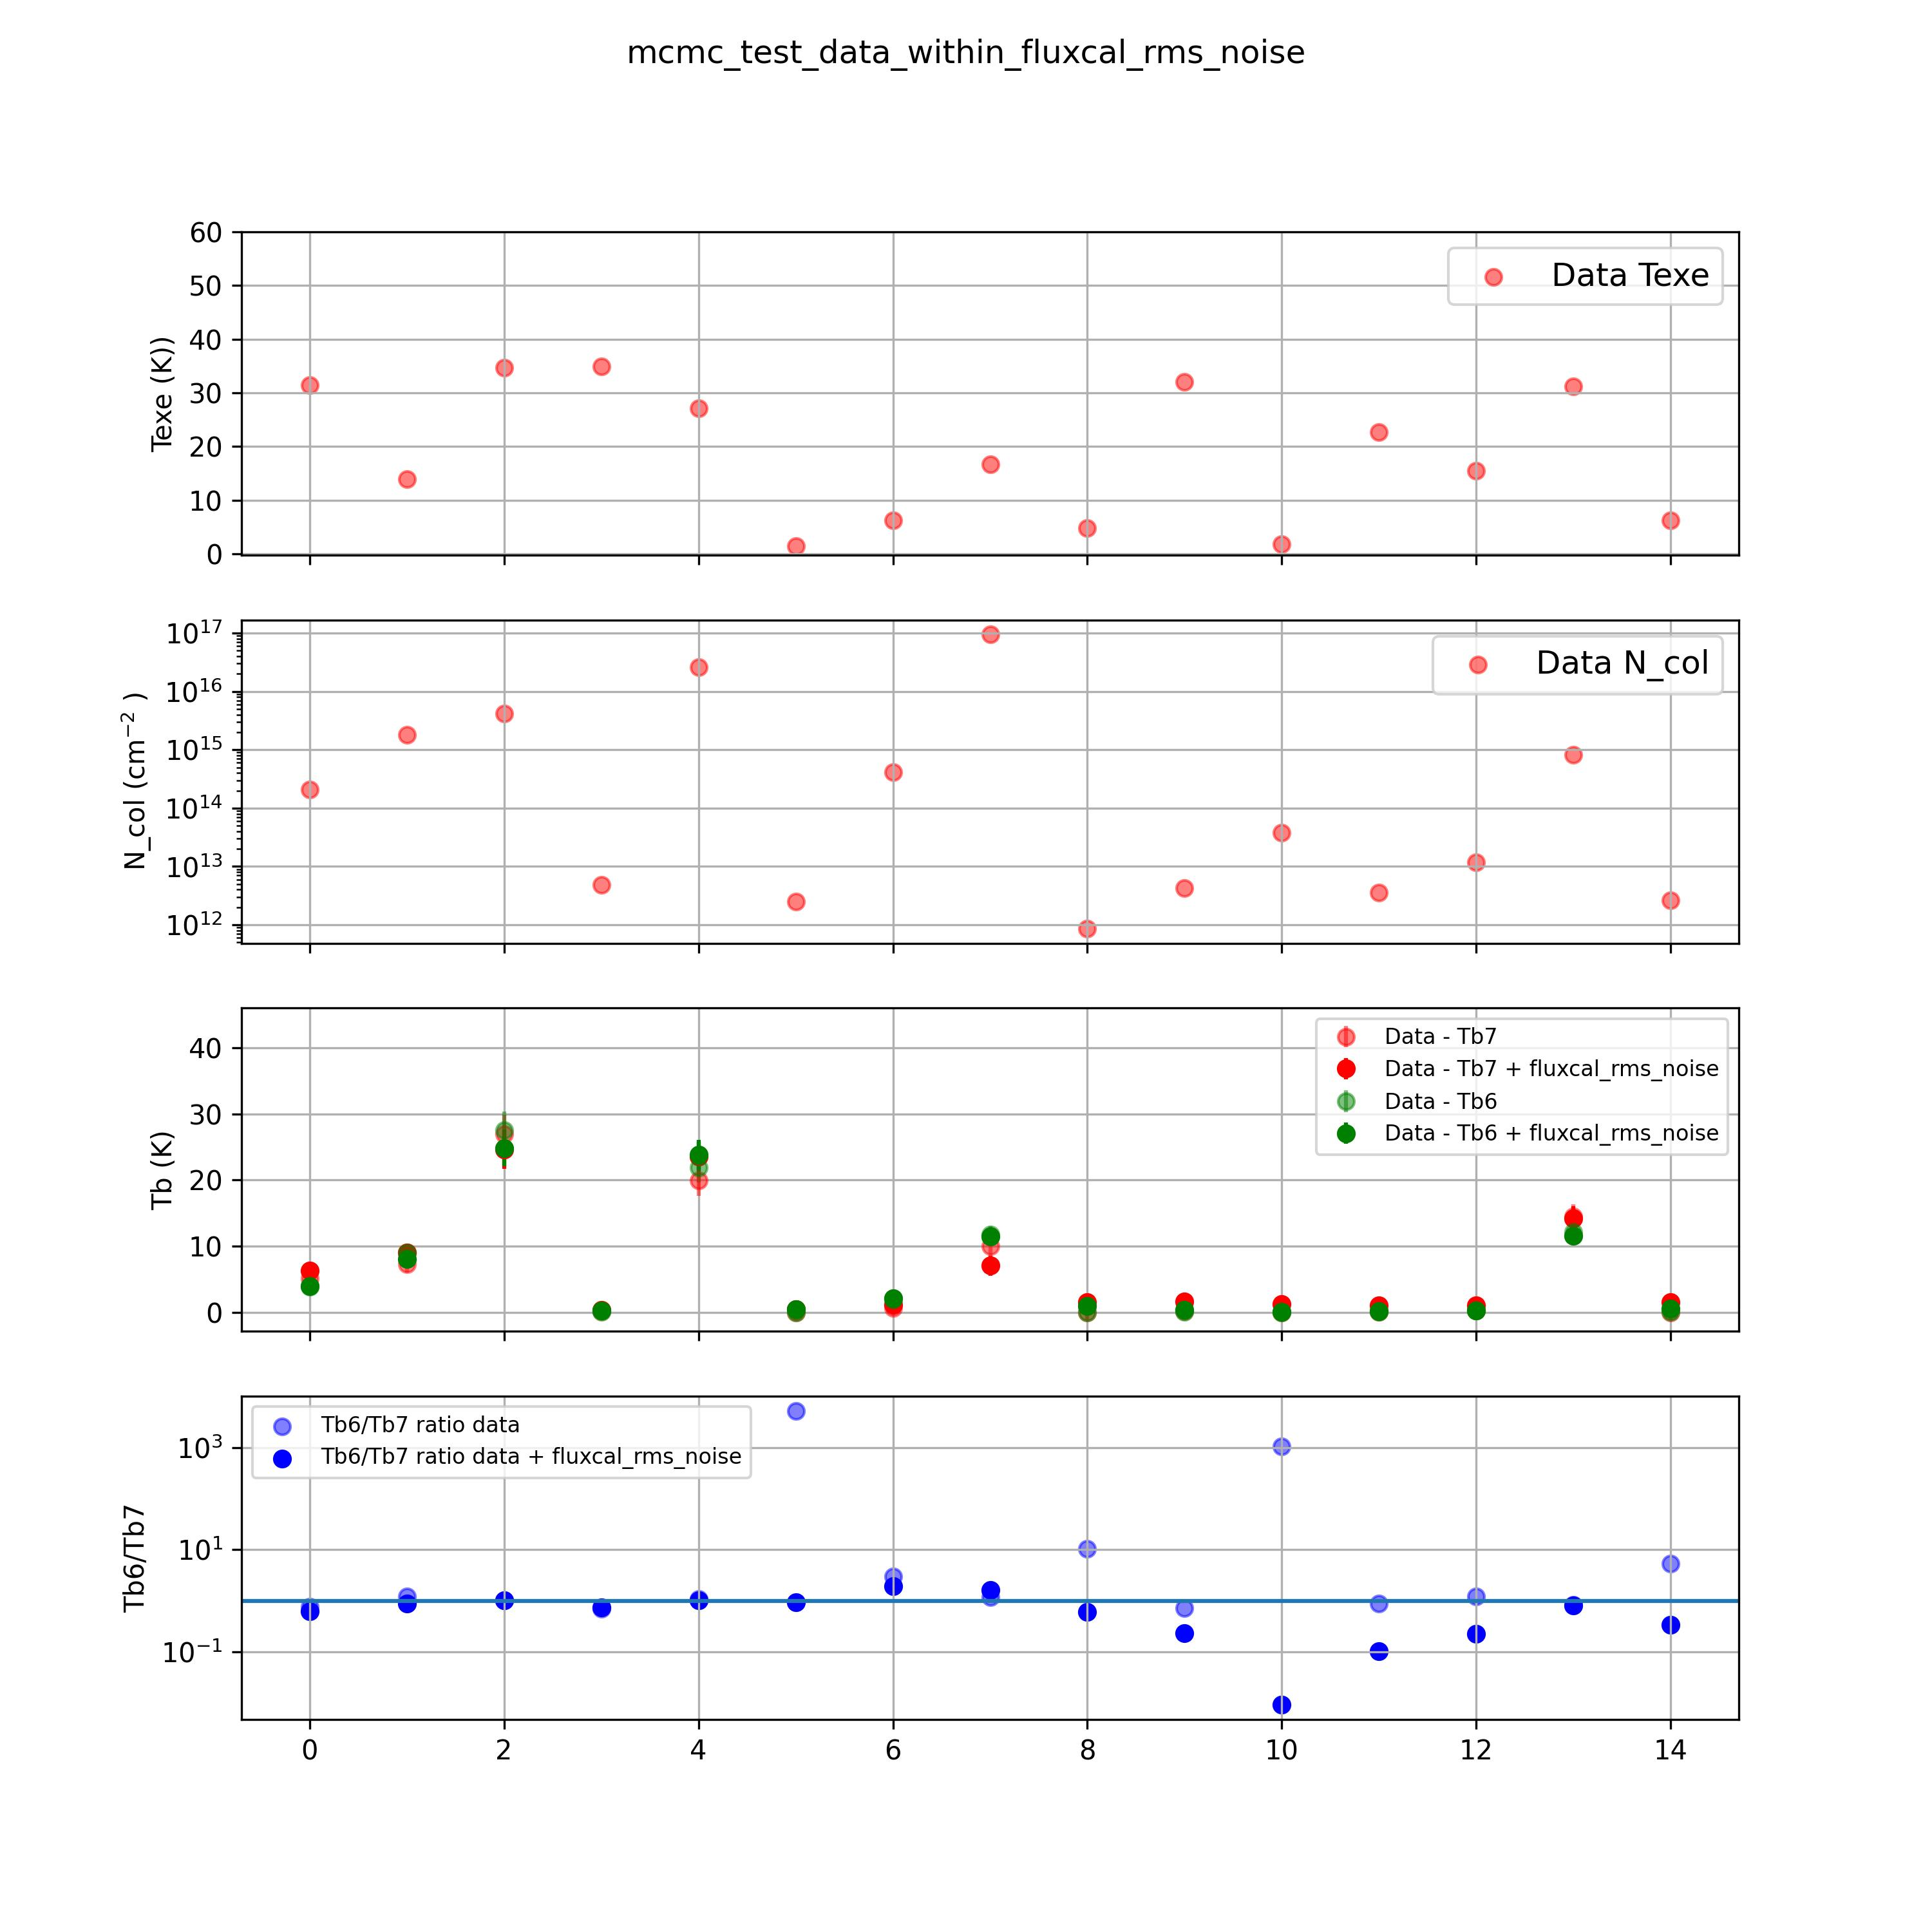
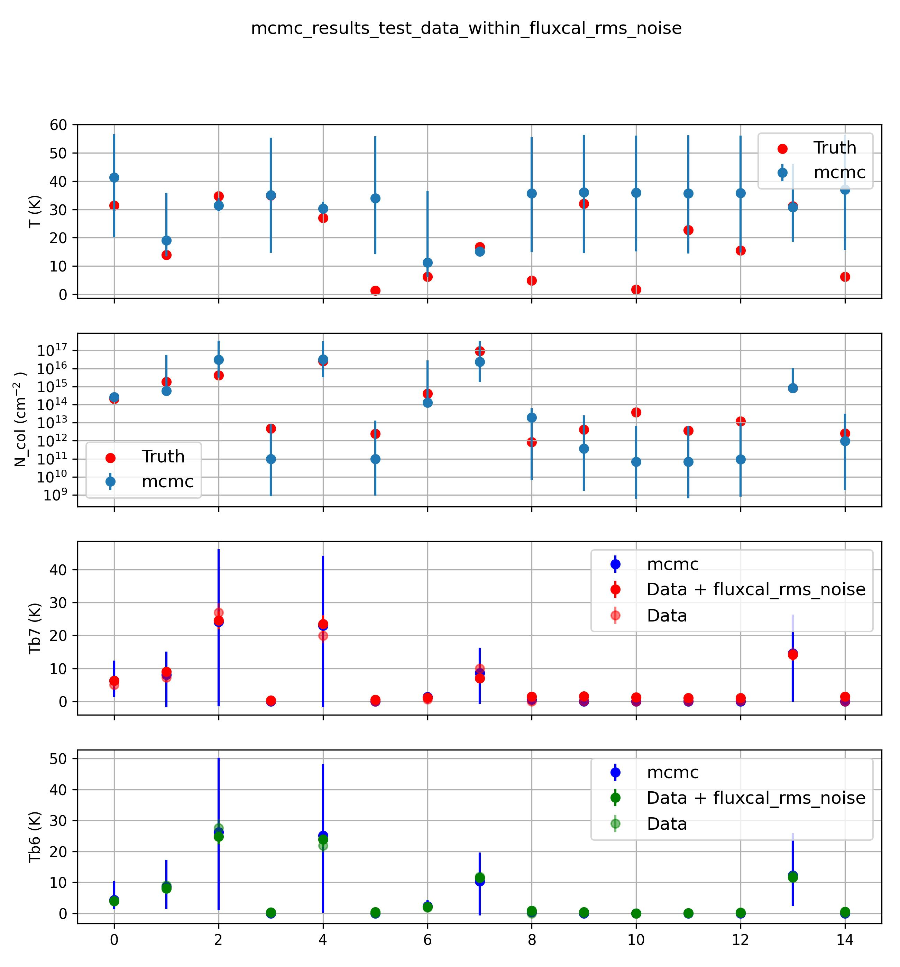
Notes:
Data - Ncol and Texe from Normal distribution around mid values
In general Tb6>Tb7
Observations – When lg(Ncol)<13.5 → Tb6<~Tb7 (i.e points 3,5,8,9 , may be 0)
When Texe ~ 10 K (i.e points 1,4) -- > No noticeable change from normal trend
Results:
For points where col density is low → Large errors in recovering the parameters

Slide 4
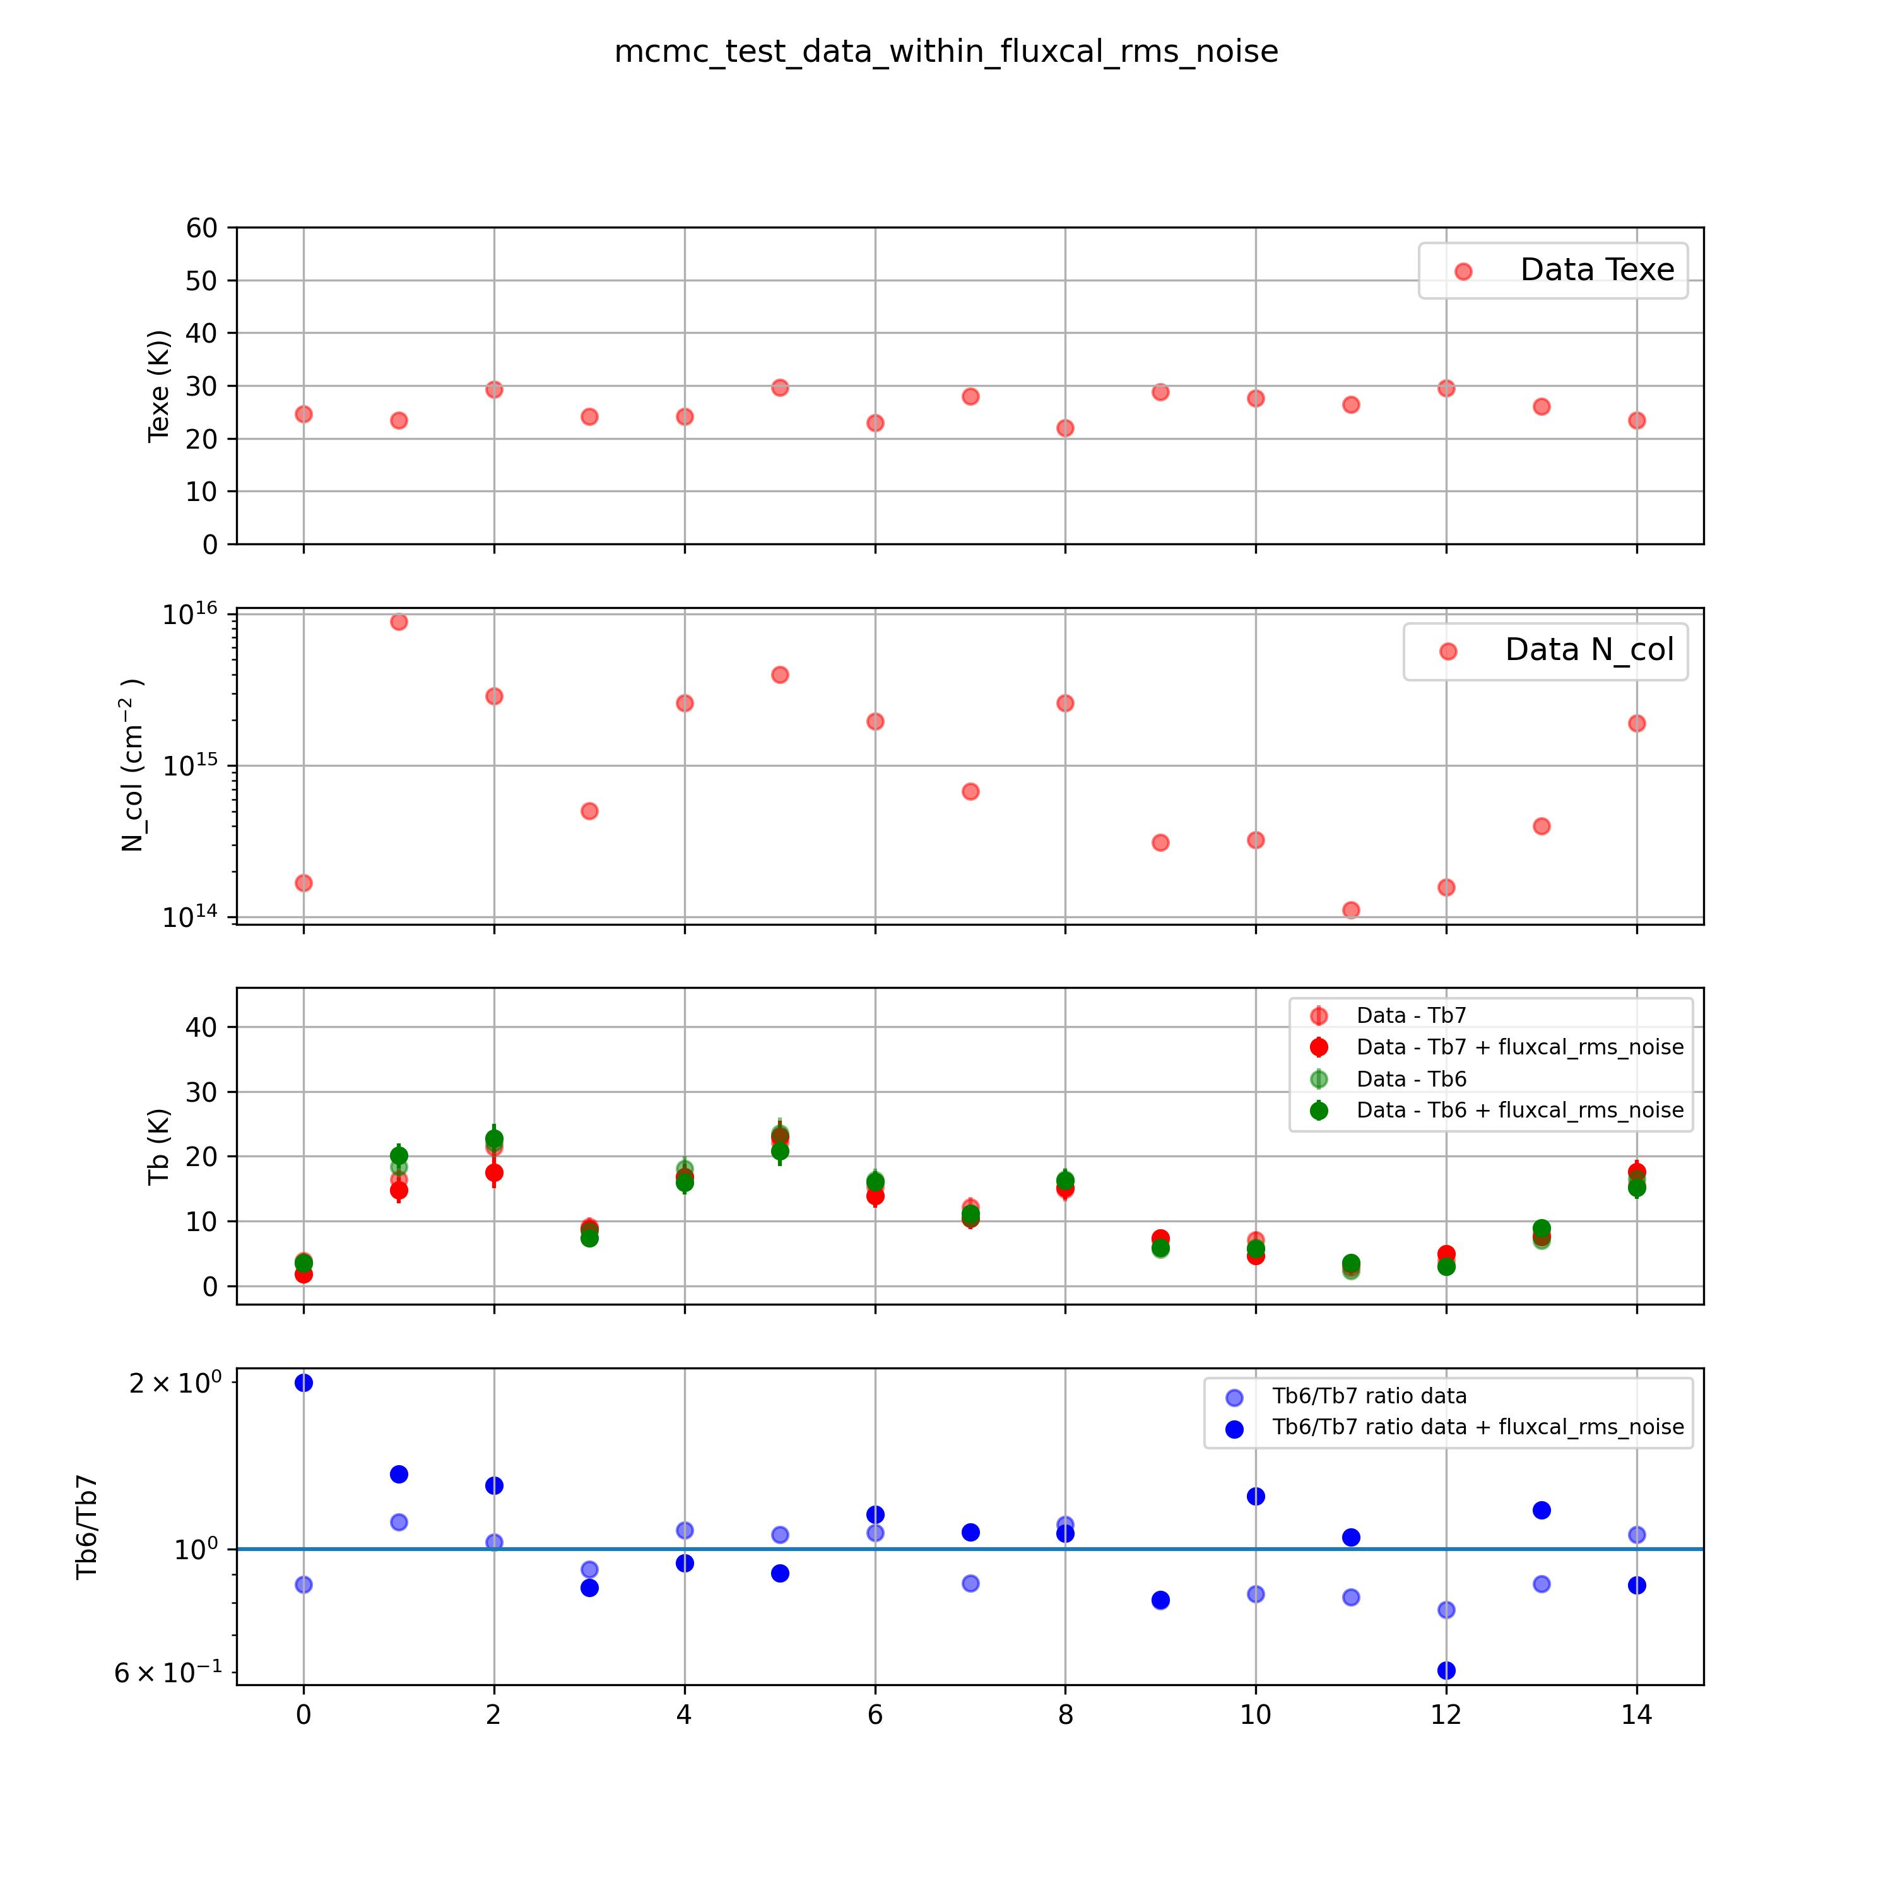
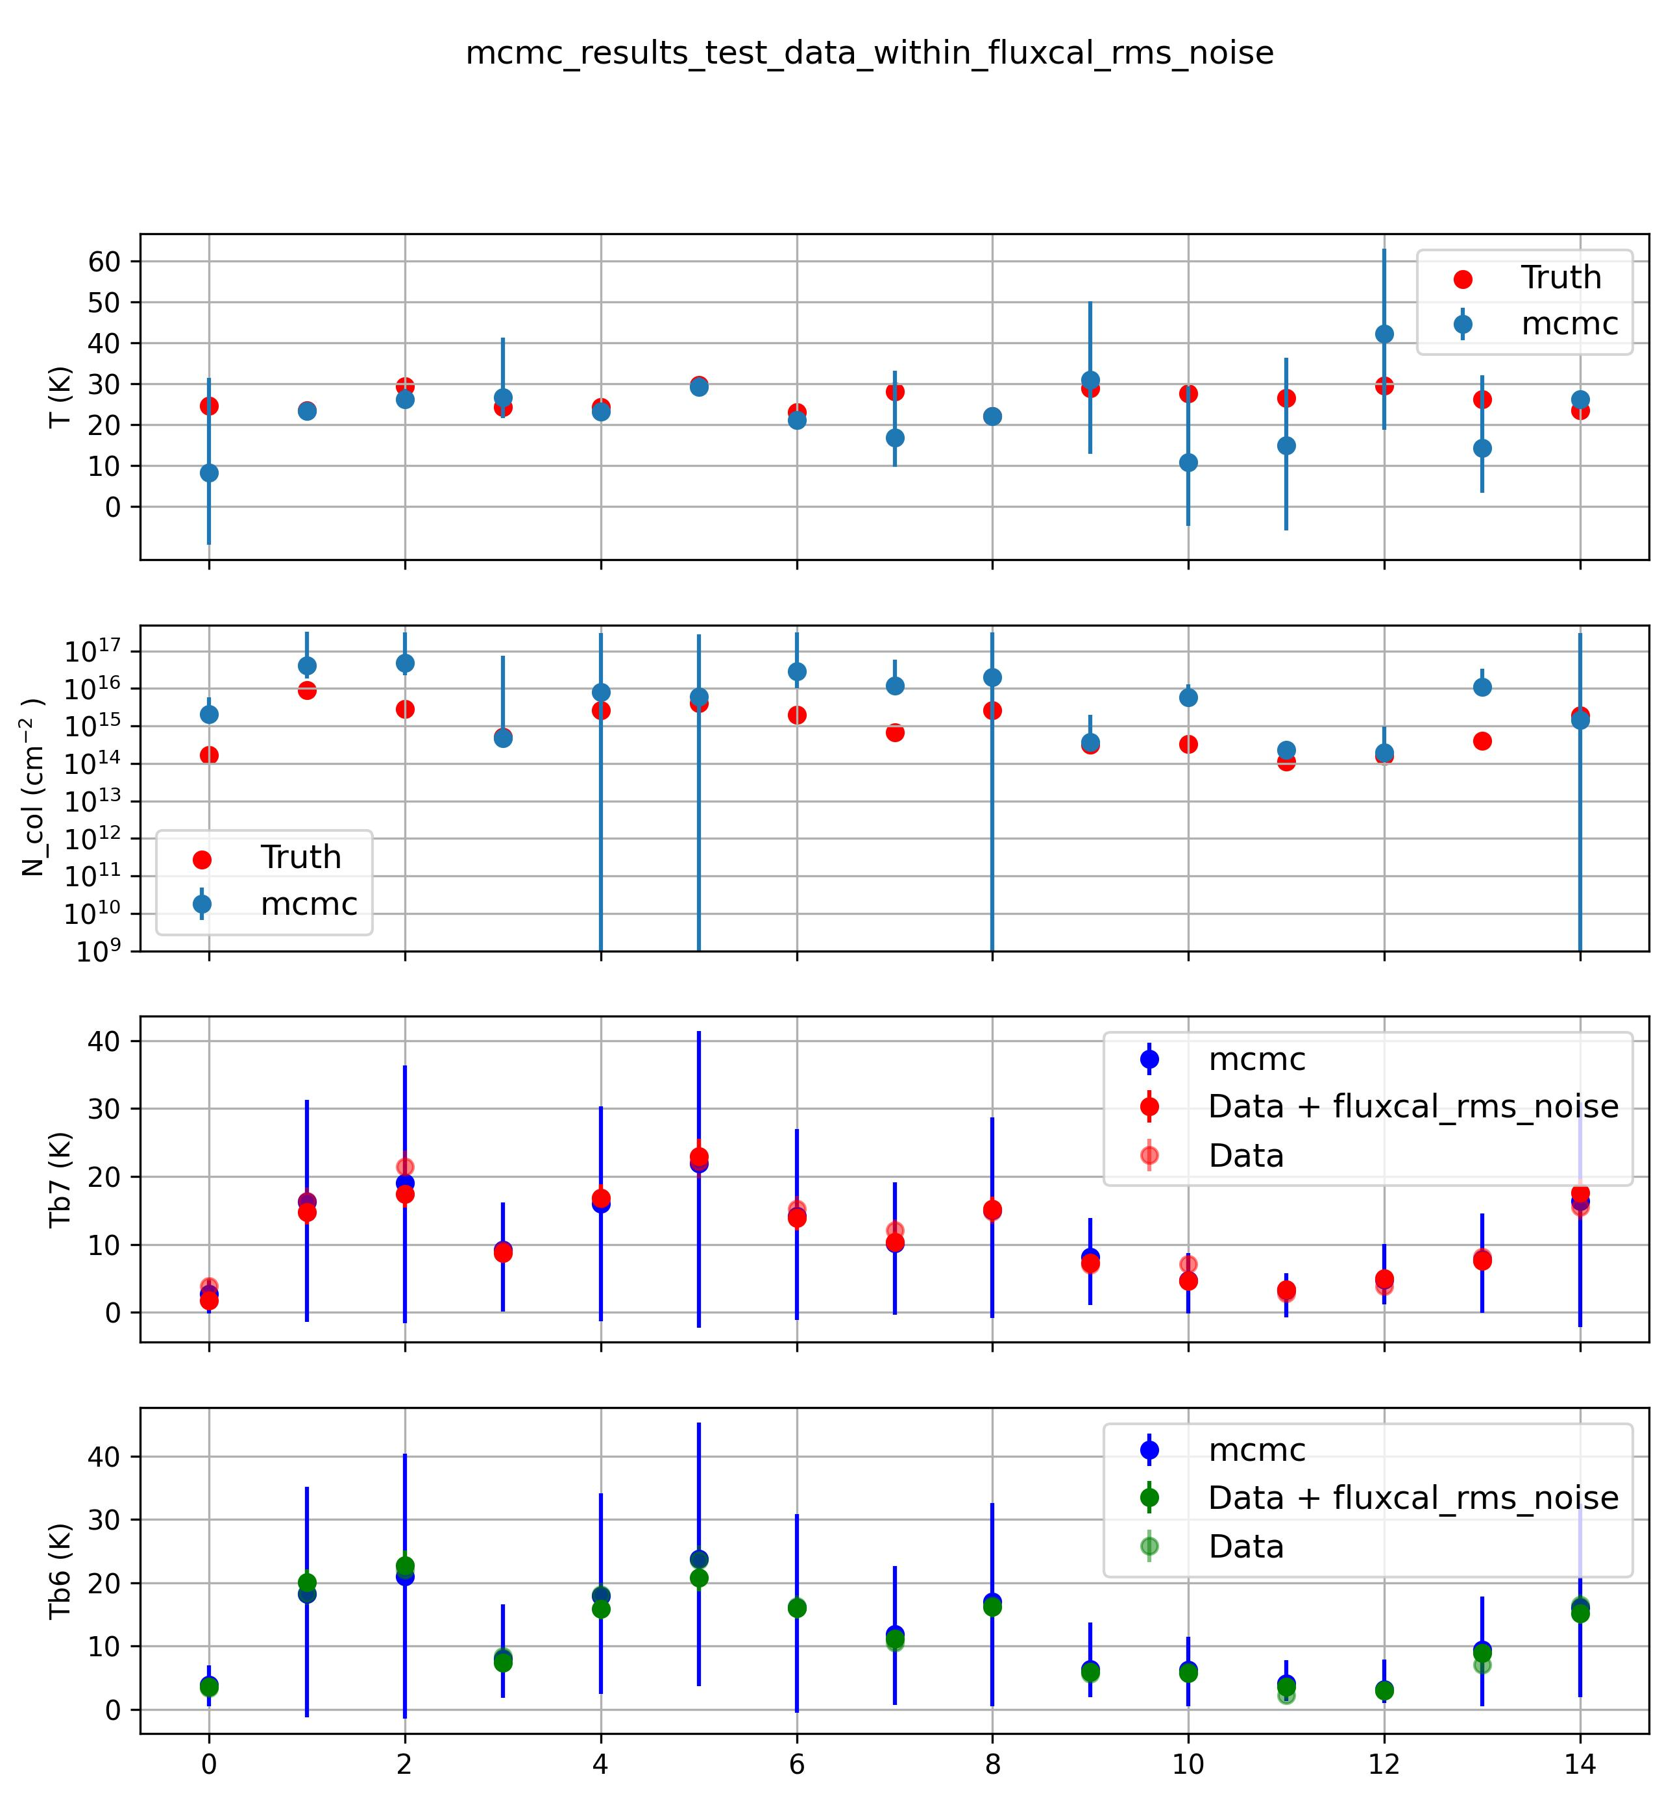
Notes:
Data - Ncol and Texe from Normal distribution around mid values
In general Tb6>Tb7
Observations – When lg(Ncol)<13.5 → Tb6<~Tb7 (i.e points 3,5,8,9 , may be 0)
When Texe ~ 10 K (i.e points 1,4) -- > No noticeable change from normal trend
Results:
For points where col density is low → Large errors in recovering the parameters

Slide 5
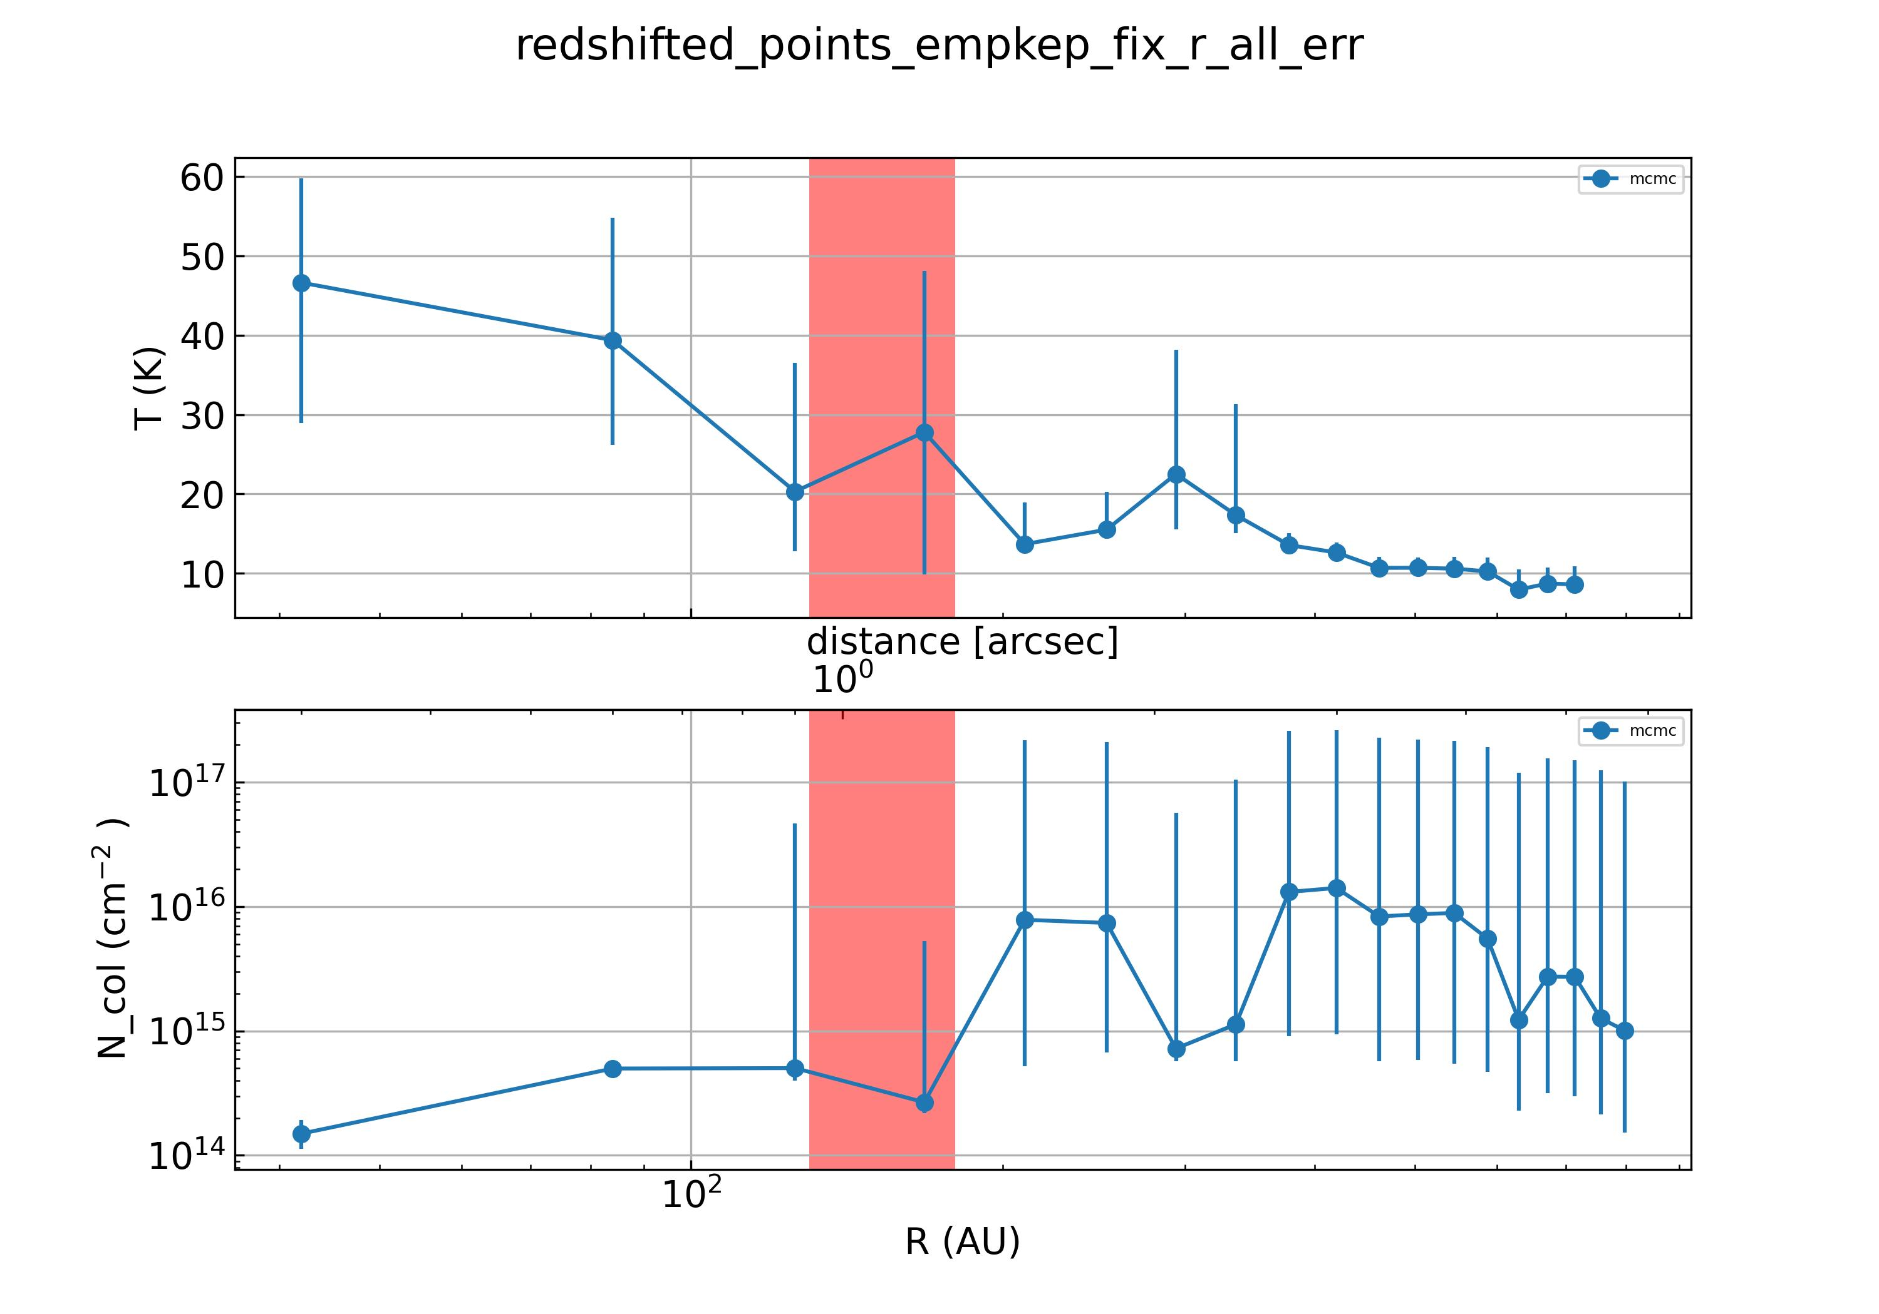
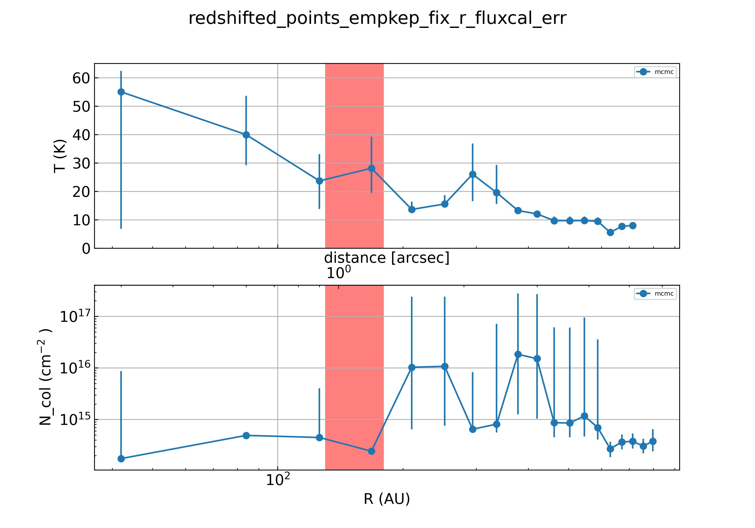

Slide 6
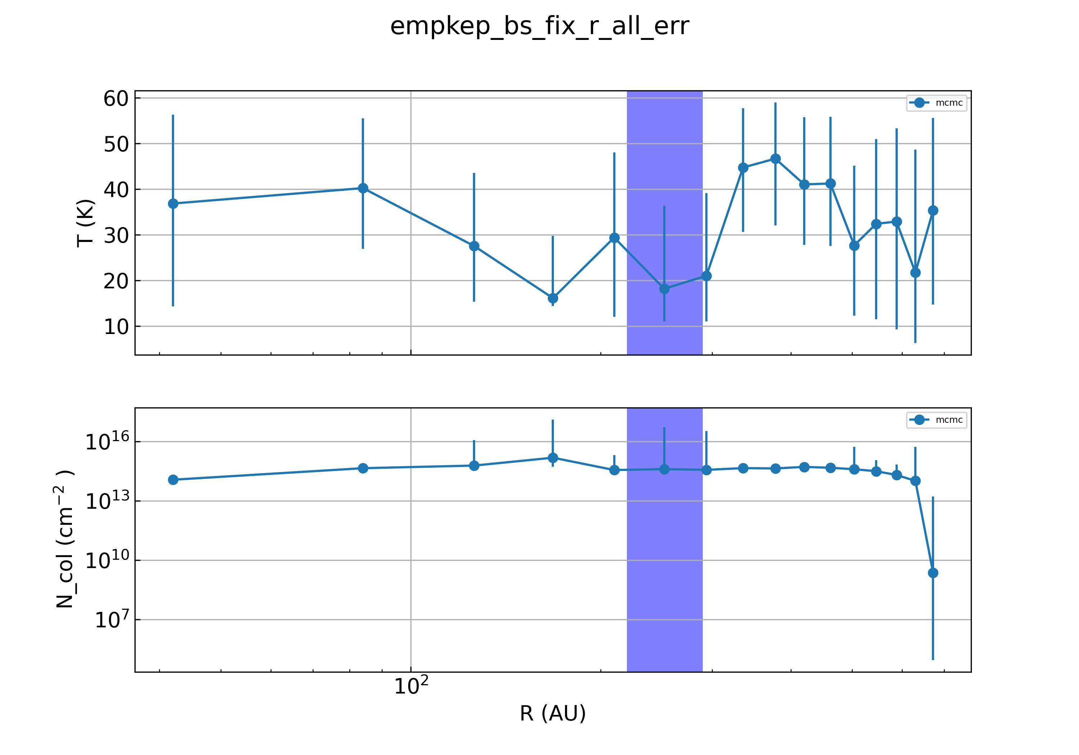
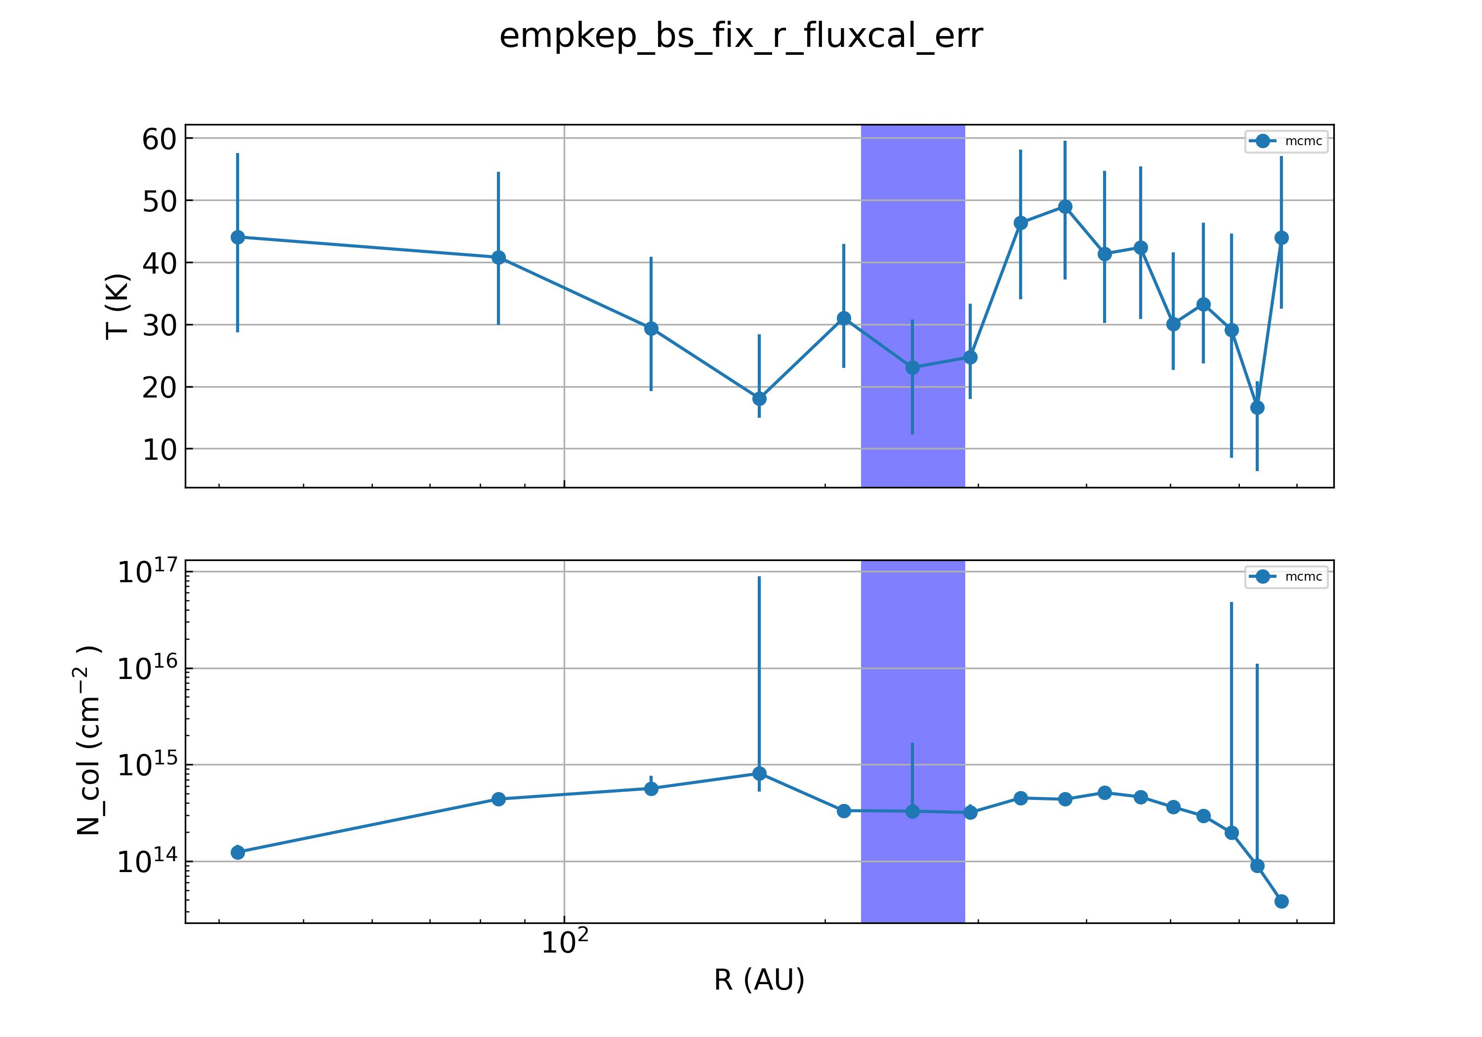

Slide 7
